Slide 1
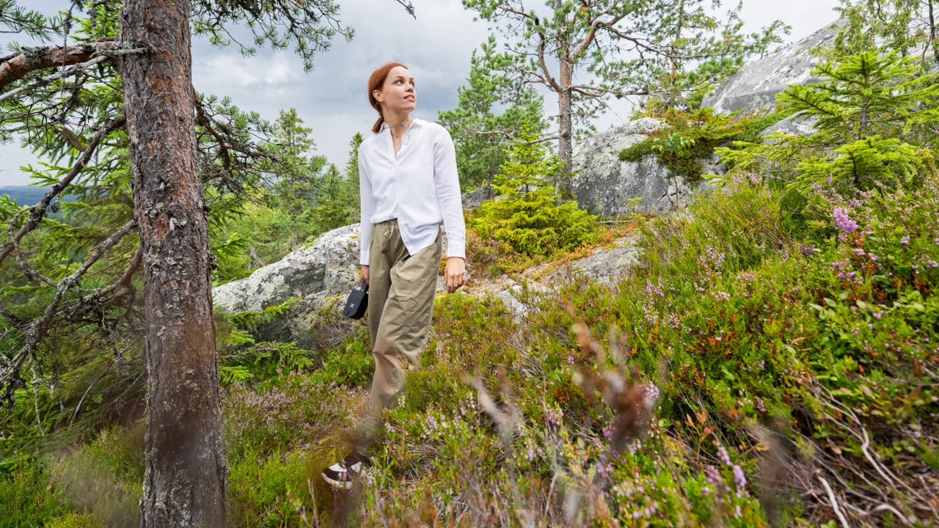


Slide 2

In Eastern Finland, North Europe, our winters are cold. But our summers – and welcome – are warm.
Here, growth comes from space, and world-class expertise meets an easy-going way of life. Forests, light and curiosity fuel research, businesses and solutions that reach the world – and that will be needed tomorrow.
People are known by name and invited to the same table. Here, you can think big, experiment boldly and live freely.
That is why North Karelia is the world’s best North Karelia for doing a good work and living a good life.

Slide 3


Notes:
Growth often starts in unexpected places, and North Karelia is proof. Here, there is room to think big, move with agility and grow fast.
Growth-driven thinking shows in both the renewal of traditional livelihoods and the building of new expertise. Around one quarter of the region’s fields are organic, and North Karelia is Finland’s leading region in organic farming.
Valio’s Joensuu factory is growing thanks to a €30 million investment. In Outokumpu, GTK Mintec researches and pilots mineral and circular economy solutions, as well as ways to reduce the environmental impacts of mining.
The region has production, investment and environments where new solutions can be tested in practice.

Slide 4


Energy, bioeconomy, forestry and clean energy investments worth €1.2 billion are in the pipeline. Fortum and Tornator are advancing the launch of wind power production.
Home to internationally successful companies, including John Deere, Abloy, Kesla, Thermo Fisher Scientific, Exel Composites, Phillips Medisize, Broman Group (Motonet) and Mantsinen Group.
Valio's Joensuu plant has grown into one of Finland's most significant food industry production facilities. A planned €30 million investment will further strengthen its position.
Notes:
Growth often starts in unexpected places, and North Karelia is proof. Here, there is room to think big, move with agility and grow fast.
Growth-driven thinking shows in both the renewal of traditional livelihoods and the building of new expertise. Around one quarter of the region’s fields are organic, and North Karelia is Finland’s leading region in organic farming.
Valio’s Joensuu factory is growing thanks to a €30 million investment. In Outokumpu, GTK Mintec researches and pilots mineral and circular economy solutions, as well as ways to reduce the environmental impacts of mining.
The region has production, investment and environments where new solutions can be tested in practice.

Slide 5
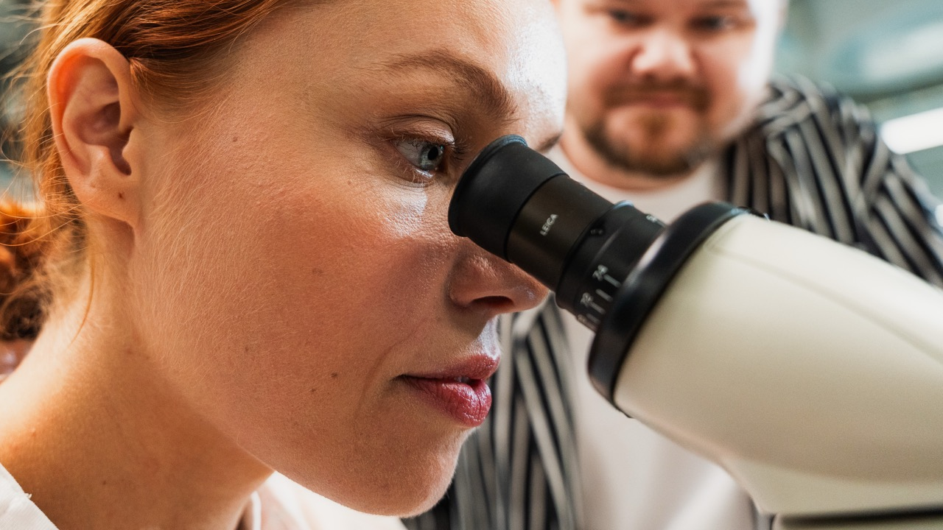

Notes:
In North Karelia, technology is not distant talk about the future. It is a way to tackle the world’s most important questions. It is researched, taught and turned into practical solutions.
Joensuu has been at the forefront of photonics — technology based on light — since the 1970s. Expertise in the field is built at Riveria, Karelia University of Applied Sciences and the University of Eastern Finland all the way to doctoral education.
The same region is home to Kelluu research airships and the carbon-binding concrete products created through the collaboration between Carbonaide and Lakka.
Here, education produces talent, research produces knowledge and companies create practical solutions. In North Karelia, technology moves from research to pilot and from pilot to sustainable business.

Slide 6
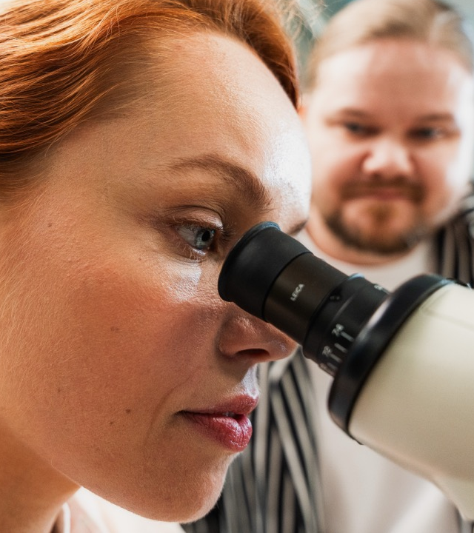

Finland's largest photonics cluster for research, education and business is located in Joensuu. Photonics is part of everyday life for all of us – a smartphone display, for example, is an application of photonics.
GTK Mintec in Outokumpu develops new solutions for the minerals and circular economy and more sustainable mining.
Carbonaide has developed a way to bind carbon dioxide into concrete. Biochar is also produced in the region as a substitute for fossil raw materials.
Airships made by Kelluu take to the skies to gather environmental data around the world.
Notes:
In North Karelia, technology is not distant talk about the future. It is a way to tackle the world’s most important questions. It is researched, taught and turned into practical solutions.
Joensuu has been at the forefront of photonics — technology based on light — since the 1970s. Expertise in the field is built at Riveria, Karelia University of Applied Sciences and the University of Eastern Finland all the way to doctoral education.
The same region is home to Kelluu research airships and the carbon-binding concrete products created through the collaboration between Carbonaide and Lakka.
Here, education produces talent, research produces knowledge and companies create practical solutions. In North Karelia, technology moves from research to pilot and from pilot to sustainable business.

Slide 7


Notes:
There are many kinds of wealth. In North Karelia, one of the richest is knowledge — and the hope for the future it creates. North Karelia is a region of education, where people can become experts and professionals in fields that truly matter.
Joensuu has around 13,000 higher education students. In 2026, the city ranked first as Finland’s best student city based on student satisfaction, and a significant share of Finland’s teachers are educated here.
Knowledge-rich does not mean student numbers alone. In the region, people can build expertise in education, photonics, forests and future environmental solutions, for example.
For companies and society, this means especially important talent for our future, research partners and the ability to renew.

Slide 8


Joensuu – home to 13,000 higher education students and Finland's best student city based on student satisfaction.
With 12 fields of study, the University of Eastern Finland is Finland's most multidisciplinary research university.
A significant share of Finland's teachers are educated here – alongside experts in the forest bioeconomy and environmental solutions of the future.
In law, the University of Eastern Finland is Finland's highest-ranked university in the international ShanghaiRanking 2026 Global Ranking of Academic Subjects.
Notes:
There are many kinds of wealth. In North Karelia, one of the richest is knowledge — and the hope for the future it creates. North Karelia is a region of education, where people can become experts and professionals in fields that truly matter.
Joensuu has around 13,000 higher education students. In 2026, the city ranked first as Finland’s best student city based on student satisfaction, and a significant share of Finland’s teachers are educated here.
Knowledge-rich does not mean student numbers alone. In the region, people can build expertise in education, photonics, forests and future environmental solutions, for example.
For companies and society, this means especially important talent for our future, research partners and the ability to renew.

Slide 9
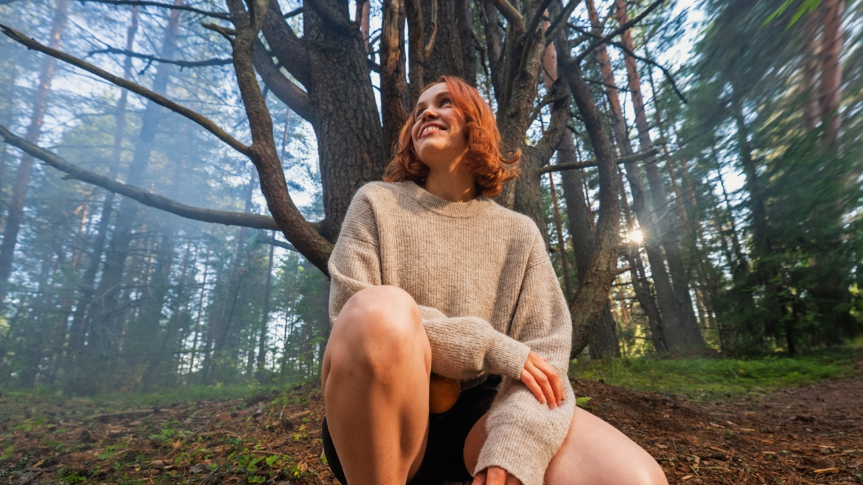

Notes:
In North Karelia, we understand that green growth is not empty talk, but a smarter way to do things. Here, forests are not seen only as raw material. They are also a source of research, knowledge, technology, education, new business and life.
Joensuu serves as the Forest Capital of Europe, bringing together companies, researchers, educators and developers in the field. Forest Joensuu’s international work has received the President of Finland’s Internationalization Award.
The region also develops future environmental solutions, such as ways to help curb wildfires around the world. Forest bioeconomy expertise is exported internationally.
North Karelia is not just home to top forest-sector experts, but to a broad concentration where research, education, companies and practical development support one another.

Slide 10


Joensuu is the Forest Capital of Europe, home to more than 600 forest bioeconomy companies and around 6,000 jobs in the sector.
Companies and research, education and development organisations work together to create new innovations and business in the forest bioeconomy and circular economy.
The Forest Joensuu network takes our expertise to the world. The President of Finland has awarded the network the Internationalisation Award.
Notes:
In North Karelia, we understand that green growth is not empty talk, but a smarter way to do things. Here, forests are not seen only as raw material. They are also a source of research, knowledge, technology, education, new business and life.
Joensuu serves as the Forest Capital of Europe, bringing together companies, researchers, educators and developers in the field. Forest Joensuu’s international work has received the President of Finland’s Internationalization Award.
The region also develops future environmental solutions, such as ways to help curb wildfires around the world. Forest bioeconomy expertise is exported internationally.
North Karelia is not just home to top forest-sector experts, but to a broad concentration where research, education, companies and practical development support one another.

Slide 11
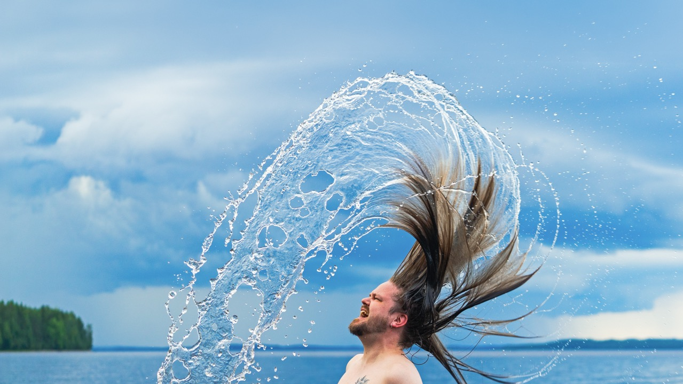

Notes:
This is exactly the kind of time that needs more North Karelia. Here, you are allowed to be sensitive and rough around the edges, direct and soft at the same time. To make art, with a big heart.
Ilosaarirock has been playing in Joensuu since 1971, raising new generations with the right attitude. At the same time, a new cultural wave is under way in this traditional rock city. Young people do not merely have hobbies; they create culture ambitiously and wholeheartedly.
Kerubi and other venues keep culture moving all year round through live music, comedy, theatre and other programming. When an event grows bigger than the building, it spreads to Ilosaari or moves to the arena.

Slide 12


Ilosaarirock has been rocking since 1971, raising new generations with the right attitude.
Our roots inspire distinctive music – from Nightwish and Ismo Alanko to Goldielocks and LounaOnline.
Gigs, comedy, theatre, theme parties and whatever else — makers find venues, support
and audiences.
Here, you don't have to fit the mould. You are free to make, create and live your own way.
Notes:
This is exactly the kind of time that needs more North Karelia. Here, you are allowed to be sensitive and rough around the edges, direct and soft at the same time. To make art, with a big heart.
Ilosaarirock has been playing in Joensuu since 1971, raising new generations with the right attitude. At the same time, a new cultural wave is under way in this traditional rock city. Young people do not merely have hobbies; they create culture ambitiously and wholeheartedly.
Kerubi and other venues keep culture moving all year round through live music, comedy, theatre and other programming. When an event grows bigger than the building, it spreads to Ilosaari or moves to the arena.

Slide 13
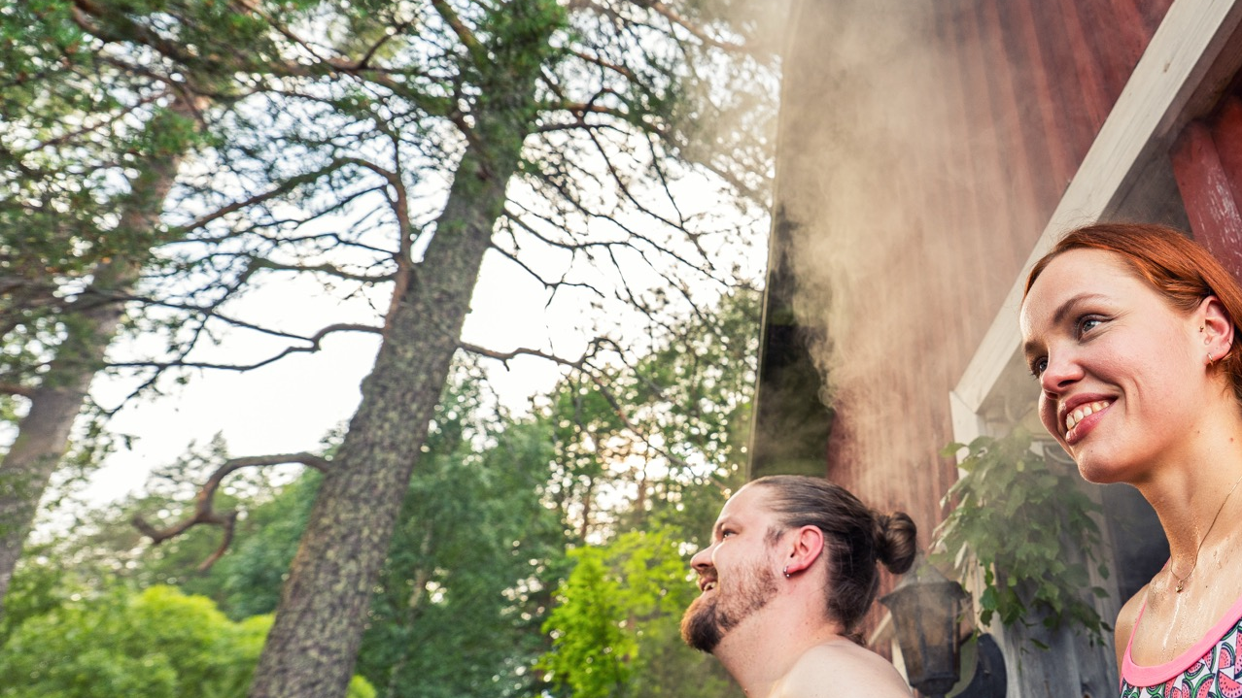

Notes:
Conversation and hospitality run deep here. In North Karelia, people do not disappear into processes or screens. They are known by name, invited to the table, and asked — properly asked — how they are really doing. Whether you meet at a family celebration, at work, at the market square or for the very first time.
North Karelia ranked among the top three when people were asked where Finland’s nicest people live (Ilta-Sanomat, 2026). Recommendation scores are also strong: North Karelia receives an NPS of +57 as a place to live, and if work made moving possible, the score is +73.
Here, help comes before forms, Karelian pies before meetings, and truth before small talk. We are direct, sometimes maybe a little too honest, but never indifferent.
And that matters for how cooperation, studying, work and moving to the region feel.

Slide 14


Conversation, familiarity and hospitality are second nature to us.
Research shows that North Karelia is home to some of Finland's nicest people – speaking its most easy-going dialect.
Our spirit of doing things together welcomes everyone and leaves no one behind.
Notes:
Conversation and hospitality run deep here. In North Karelia, people do not disappear into processes or screens. They are known by name, invited to the table, and asked — properly asked — how they are really doing. Whether you meet at a family celebration, at work, at the market square or for the very first time.
North Karelia ranked among the top three when people were asked where Finland’s nicest people live (Ilta-Sanomat, 2026). Recommendation scores are also strong: North Karelia receives an NPS of +57 as a place to live, and if work made moving possible, the score is +73.
Here, help comes before forms, Karelian pies before meetings, and truth before small talk. We are direct, sometimes maybe a little too honest, but never indifferent.
And that matters for how cooperation, studying, work and moving to the region feel.

Slide 15
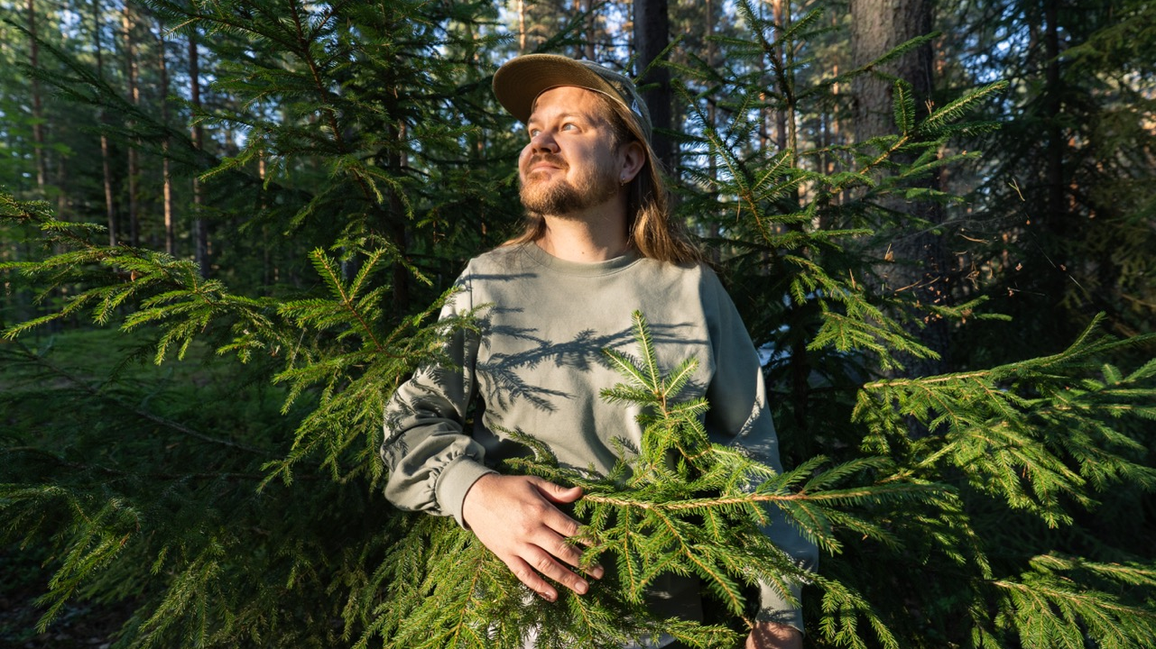

Notes:
There is only one North Karelia, and it is the world’s most superlative North Karelia.

Slide 16
Notes:
Maailmassa on vain yksi Pohjois-Karjala ja se on maailman superlatiivisin Pohjois-Karjala.

